Slide 1
Multi-Agent
Hailiang Chen
HKU Business School

Slide 3
Why Multi-Agent?
Context Management
Deliver specialized knowledge without overloading the context window
Selectively surface relevant information instead of one large prompt
Distributed Development
Different teams build and maintain agents independently
Modular design with clear boundaries
Parallelization
Specialized agents handle subtasks concurrently
Faster overall execution
Notes:
1. 过长的prompt，需要被切割 2. 复杂的task，需要多个step，多个tool calling, input and output, 导致context非常长 3.增加token cost 4. 每个agent单独负责一个任务，减少context 5.

Slide 4
When to use Multi‑Agent?
A single agent has too many tools and makes poor tool‑selection decisions
Tasks require deep domain expertise with long prompts or specialized tools
Sequential constraints are needed (capabilities unlocked only after conditions are met)

Slide 5
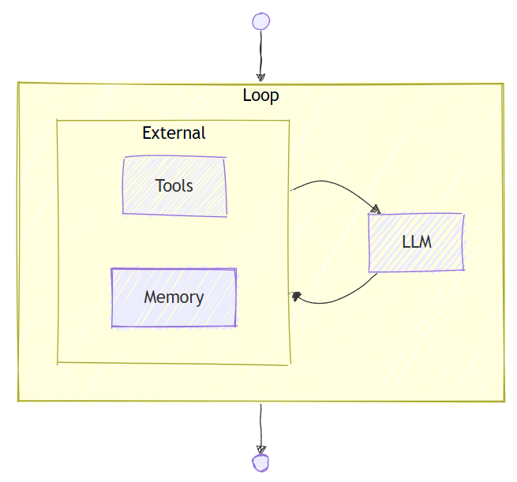
Agent

Slide 6
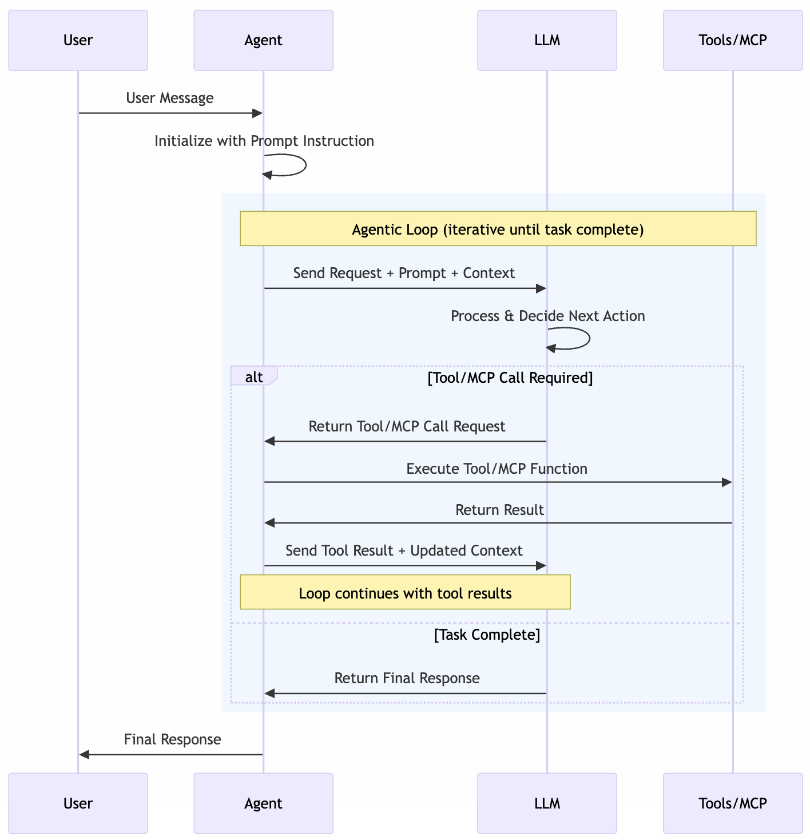

Slide 7
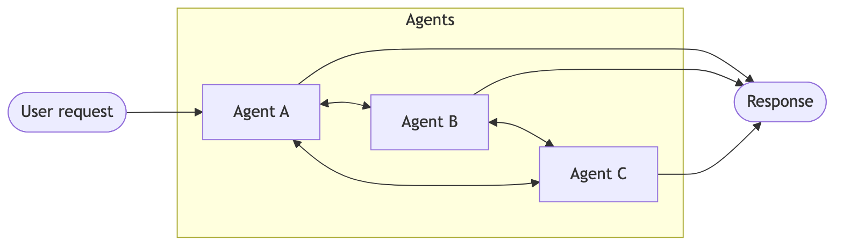
Multi-Agent

Slide 8
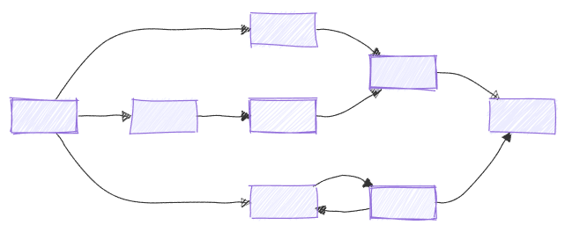
Workflow

Slide 9
When to use agents vs workflows
Use an agent when… | Use a workflow when…
The task is open-ended or conversational | The process has well-defined steps
You need autonomous tool use and planning | You need explicit control over execution order
A single LLM call (possibly with tools) suffices | Multiple agents or functions must coordinate

Slide 10
Microsoft Agent Framework
Successor to AutoGen and Semantic Kernel, built by the same teams
Combines AutoGen’s simple agent abstractions with Semantic Kernel’s enterprise features
Enterprise‑grade capabilities: session‑based state, type safety, filters, telemetry
Graph‑based workflows for explicit multi‑agent orchestration
Designed for long‑running and human‑in‑the‑loop scenarios
Notes:
新录音在上一页开始 graph，上2页，的workflow

Slide 11
Microsoft Agent Framework
Agents - provides a consistent interface and enables different features like multi-agent orchestration. Out of the box, agents support function calling, multi-turn conversations with chat history, service-provided tools, structured outputs, and streaming responses.
Chat providers - provide abstractions for connecting to AI services from different providers under a common interface. Supported providers include Azure OpenAI, OpenAI, Anthropic, Copilot, and more through the BaseAgent abstraction.
Function tools - containers for custom functions that extend agent capabilities. Agents can automatically invoke functions to integrate with external APIs and services.

Slide 12
Microsoft Agent Framework
Built-in tools - prebuilt capabilities including Code Interpreter for Python execution, File Search for document analysis, and Web Search for internet access.
Conversation management - structured message system with roles (USER, ASSISTANT, SYSTEM, TOOL) and AgentSession for persistent conversation context across interactions.
Workflow orchestration - supports sequential workflows, concurrent execution, group chat, and handoff patterns for complex multi-agent collaboration.
Notes:
09：50，录音28

Slide 13
Workflow Core Concepts
Executors
represent individual processing units within a workflow.
They can be AI agents or custom logic components.
They receive input messages, perform specific tasks, and produce output messages.
Edges
define the connections between executors, determining the flow of messages.
They can include conditions to control routing based on message contents.

Slide 14
Workflow Core Concepts
Events
provide observability into workflow execution, including lifecycle events, executor events, and custom events.
Workflow Builder & Execution
ties executors and edges together into a directed graph
manages execution via supersteps
supports streaming and non-streaming modes.

Slide 15
Workflow Key Features
Type Safety: Strong typing ensures messages flow correctly between components, with comprehensive validation that prevents runtime errors.
Flexible Control Flow: Graph-based architecture allows for intuitive modeling of complex workflows with executors and edges. Conditional routing, parallel processing, and dynamic execution paths are all supported.
External Integration: Built-in request/response patterns for seamless integration with external APIs, and human-in-the-loop scenarios.
Checkpointing: Save workflow states via checkpoints, enabling recovery and resumption of long-running processes on server sides.存档
Multi-Agent Orchestration: Built-in patterns for coordinating multiple AI agents, including sequential, concurrent, hand-off, and magentic.
Notes:
电脑录音开始

Slide 16
Executors
Each executor has a unique identifier and can handle specific message types.
Custom logic components — process data, call APIs, or transform messages
Basic Executor Structure
Executors inherit from the Executor base class.
Each executor uses methods decorated with the @handler decorator.
Handlers must have proper type annotations to specify the message types they process.
Function-based Executors
Create an executor from a function using the @executor decorator.
AI agents
Notes:
02：30

Slide 17
The WorkflowContext Object
The WorkflowContext provides methods for interacting with the workflow during execution:
send_message — send messages to connected executors
yield_output — produce workflow outputs returned/streamed to the caller

Slide 18
Agent Providers
Azure OpenAI
Azure OpenAI resource
Program: af-azure-openai-agent.py
Microsoft Foundry
Microsoft Foundry resource
Program: af-foundry-agent.py
Notes:
0649

Slide 19
Edges
Type | Description | Use case
Direct | Simple one-to-one connections | Linear pipelines按顺序
Conditional | Edges with conditions that determine when messages flow | Binary routing (if/else)广告邮件的分类
Switch-Case | Route to different executors based on conditions | Multi-branch routing
Multi-Selection (Fan-out) | One executor sending messages to multiple targets | Parallel processing
Fan-in | Multiple executors sending to a single target | Aggregation
Notes:
0915
connect excutor

Slide 20
Case: Hotel Booking Conditional Workflow
User provides a destination city
Agent checks hotel availability using a tool
Conditional routing:
If NO availability → Suggest alternative city
If availability → Suggest booking
Display result with HTML formatting
af-hotel-booking.py
Notes:
1414

Slide 21
Case: Hotel Booking Conditional Workflow
WorkflowBuilder with conditional edges
AgentExecutor wrapping AI agents
@executor decorator for custom logic
Pydantic models for structured outputs well-defined的输出
@tool decorator for tools
OpenAIChatClient integration

Slide 22
Events
# All events use the unified WorkflowEvent class with a type discriminator:
# Workflow lifecycle events
WorkflowEvent.type == "started" # Workflow execution begins
WorkflowEvent.type == "status" # Workflow state changed (use .state)
WorkflowEvent.type == "output" # Workflow produces an output
WorkflowEvent.type == "failed" # Workflow terminated with error (use .details)
WorkflowEvent.type == "error" # Non-fatal error from user code
WorkflowEvent.type == "warning" # Workflow encountered a warning

Slide 23
Events
# Executor events
WorkflowEvent.type == "executor_invoked" # Executor starts processing
WorkflowEvent.type == "executor_completed" # Executor finishes processing
WorkflowEvent.type == "executor_failed" # Executor encounters an error
WorkflowEvent.type == "data" # Executor emitted data (e.g., AgentResponse)
# Superstep events
WorkflowEvent.type == "superstep_started" # Superstep begins
WorkflowEvent.type == "superstep_completed" # Superstep completes
# Request events
WorkflowEvent.type == "request_info" # A request is issued

Slide 24
Workflow Builder & Execution
Building Workflows: Use the WorkflowBuilder class to define workflows with executors and edges.
Workflow Execution: Support for both streaming and non-streaming execution modes.
Workflow Validation: Ensures type compatibility, graph connectivity, executor binding, and edge validation during workflow construction.
Execution Model: Introduces a superstep-based processing model that organizes execution into discrete steps, ensuring synchronization and deterministic behavior.

Slide 25
Workflow Validation
Type Compatibility: Ensures message types are compatible between connected executors
Graph Connectivity: Verifies all executors are reachable from the start executor
Executor Binding: Confirms all executors are properly bound and instantiated
Edge Validation: Checks for duplicate edges and invalid connections

Slide 26
Execution Model: Supersteps
Workflow execution is organized into discrete supersteps. Each superstep:
Collects all pending messages from the previous superstep
Routes messages to target executors based on edge definitions
Runs all target executors concurrently within the superstep
Waits for all executors to complete before advancing (synchronization barrier)
Queues any new messages emitted by executors for the next superstep

Slide 27
Multi-Agent Orchestration Patterns
Pattern | Description
Sequential | Agents execute one after another in a defined order
Concurrent | Agents execute in parallel
Handoff | Agents transfer control to each other based on context
Group Chat | Agents collaborate in a shared conversation
Magentic | A manager agent dynamically coordinates specialized agents
Notes:
Handoff

Slide 28
A unified orchestration workflow
Define your agents and describe their capabilities.
Select and create an orchestration pattern, optionally adding a manager agent if needed.
Optionally configure callbacks or transforms for custom input and output handling.
Start a runtime to manage execution.
Invoke the orchestration with your task.
Retrieve results in an asynchronous, nonblocking way.

Slide 29
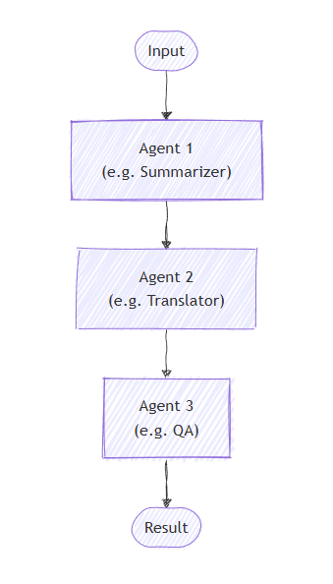
Sequential Orchestration

Slide 30
Sequential Orchestration
Shared Context: Each participant receives the full conversation history, including all previous messages
Order Matters: Agents execute strictly in the order specified in the participants list
Flexible Participants: You can mix agents and custom executors in any order
Conversation Flow: Each agent/executor appends to the conversation, building a complete dialogue
Tool Approval: Use @tool(approval_mode="always_require") for sensitive operations that need human review
Request Info: Use .with_request_info(agents=[...]) to pause after specific agents for external feedback

Slide 31
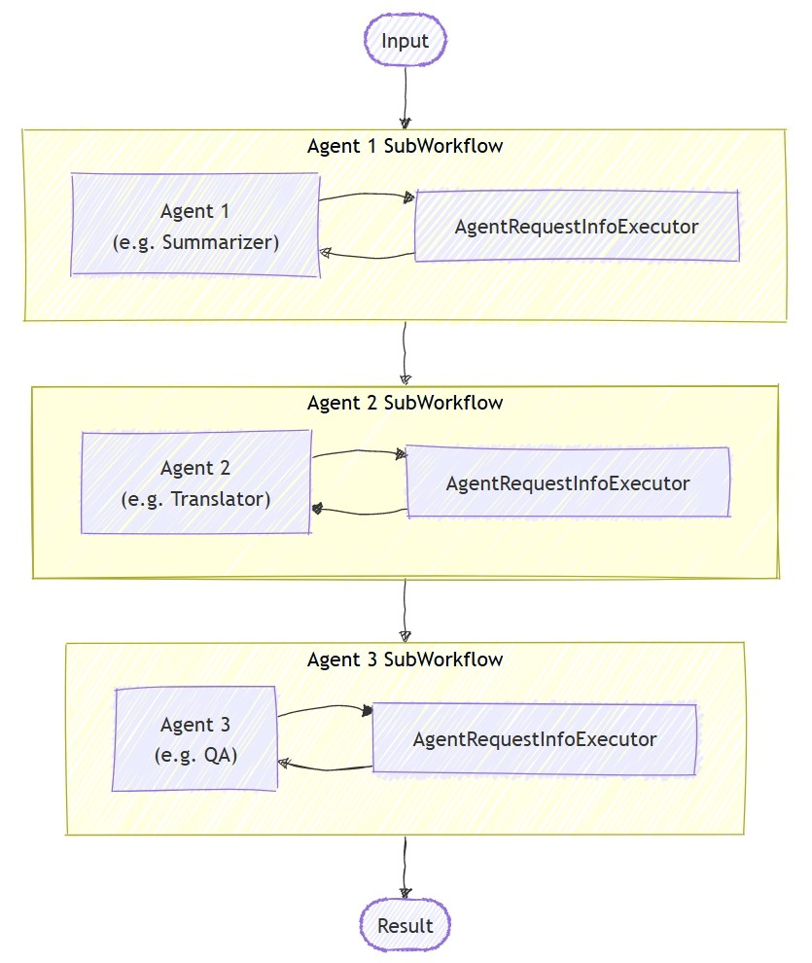
Sequential Orchestration
Create a sequential pipeline of agents
sequential_agents.py
Mixing Agents with Custom Executors
sequential_custom_executors.py
Tool Approval in Sequential Workflows
sequential_builder_tool_approval.py
Request Info for Agent Feedback
sequential_request_info.py

Slide 32
When to use sequential orchestration
Processes made up of multiple steps that must happen in a specific order, where each step relies on the one before it.
Data workflows where each stage adds something important that the next stage needs to work properly.
Tasks where stages can’t be done at the same time and must run one after another.
Situations that require gradual improvements, like drafting, reviewing, and polishing content.
Systems where you know how each agent performs and can handle delays or failures in any step without stopping the whole process.

Slide 33
When to avoid sequential orchestration
Stages can be run independently and in parallel without affecting quality.
A single agent can perform the entire task effectively.
Early stages may fail or produce poor output, and there’s no way to stop or correct downstream processing based on errors.
Agents need to collaborate dynamically rather than hand off work sequentially.
The workflow requires iteration, backtracking, or dynamic routing based on intermediate results.

Slide 34
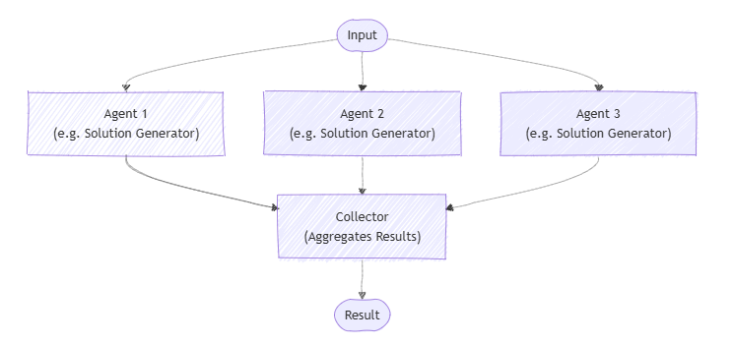
Concurrent Orchestration

Slide 35
Concurrent Orchestration
Parallel Execution: All agents work on the task simultaneously and independently
Result Aggregation: Results are collected and can be processed by either the default or custom aggregator
Diverse Perspectives: Each agent brings its unique expertise to the same problem
Flexible Participants: You can use agents directly or wrap them in custom executors
Custom Processing: Override the default aggregator to synthesize results in domain-specific ways

Slide 36
Concurrent Orchestration
Concurrent Agents
concurrent_agents.py
Custom Agent Executors
concurrent_custom_agent_executors.py
Custom Aggregator
concurrent_custom_aggregator.py

Slide 37
When to use concurrent orchestration
When tasks can run at the same time, either by using a fixed group of agents or by selecting AI agents dynamically based on what the task needs.
When the task benefits from different specialized skills or approaches (for example, technical, business, or creative) that all work independently but contribute to solving the same problem.
Brainstorming ideas
Combining different reasoning methods (ensemble reasoning)
Making decisions based on voting or consensus (quorum)
Handling tasks where speed matters and running agents in parallel cuts down wait time

Slide 38
When to avoid concurrent orchestration
Agents need to build on each other’s work or depend on shared context in a specific order.
The task requires a strict sequence of steps or predictable, repeatable results.
Resource limits, like model usage quotas, make running agents in parallel inefficient or impossible.
Agents can’t reliably coordinate changes to shared data or external systems while running at the same time.
There’s no clear way to resolve conflicts or contradictions between results from different agents.
Combining results is too complicated or ends up lowering the overall quality.

Slide 39
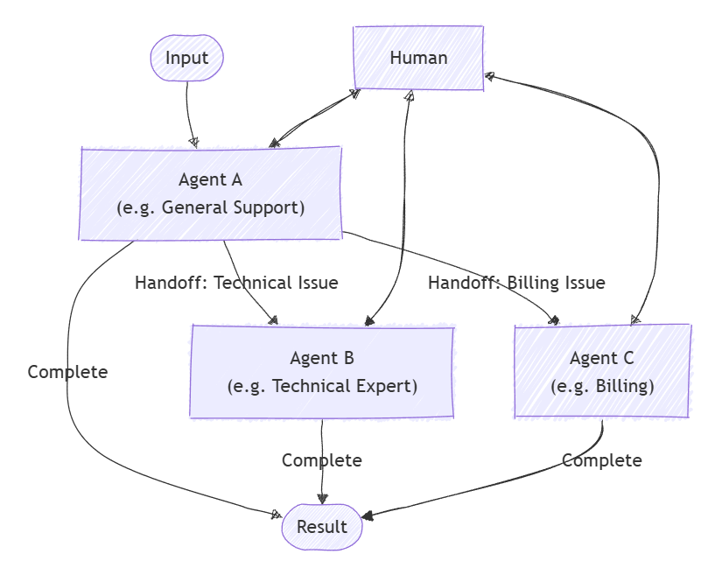
Handoff Orchestration

Slide 40
Handoff Orchestration
Dynamic Routing: Agents can decide which agent should handle the next interaction based on context
HandoffBuilder: Creates workflows with automatic handoff tool registration
with_start_agent(): Defines which agent receives user input first
add_handoff(): Configures specific handoff relationships between agents
Context Preservation: Full conversation history is maintained across all handoffs
Request/Response Cycle: Workflow requests user input, processes responses, and continues until termination condition is met

Slide 41
Handoff Orchestration
Tool Approval: Use @tool(approval_mode="always_require") for sensitive operations that need human approval
Function Approval Handling: When an agent calls a tool requiring approval, a Content object with type "function_approval_request" is emitted; use to_function_approval_response(approved=...) to respond
Checkpointing: Pass checkpoint_storage= to HandoffBuilder for durable workflows that can pause and resume across process restarts
Specialized Expertise: Each agent focuses on their domain while collaborating through handoffs

Slide 42
Handoff Orchestration
Simple handoff workflow
handoff_simple.py
Autonomous Mode
handoff_autonomous.py
Handoff Workflow with Code Interpreter File Generation
handoff_with_code_interpreter_file.py

Slide 43
When to use handoff orchestration
Tasks need specialized knowledge or tools, but the number or order of agents can't be determined in advance.
Expertise requirements emerge dynamically during processing, triggering task routing based on content analysis.
Multiple-domain problems require different specialists working sequentially.
You can define clear signals or rules indicating when an agent should transfer control and to whom.

Slide 44
When to avoid handoff orchestration
The involved agents and their order are known upfront and fixed.
Task routing is simple and rule-based, not needing dynamic interpretation.
Poor routing decisions might frustrate users.
Multiple operations must run at the same time.
Avoiding infinite handoff loops or excessive bouncing between agents is difficult.

Slide 45
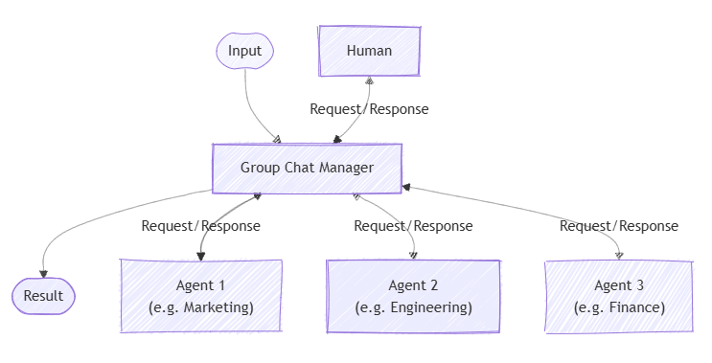
Group Chat

Slide 46
Group Chat
Flexible Orchestrator Strategies: Choose between simple selectors, agent-based orchestrators, or custom logic via constructor parameters (selection_func, orchestrator_agent, or orchestrator).
GroupChatBuilder: Creates workflows with configurable speaker selection
GroupChatState: Provides conversation state for selection decisions
Iterative Collaboration: Agents build upon each other's contributions
Event Streaming: Process AgentResponseUpdate events in real-time via workflow.run(task, stream=True)
list[Message] Output: All orchestrations return a list of chat messages

Slide 47
Group Chat
Group Chat with Simple Selector
group_chat_simple_selector.py
Group Chat with Agent-Based Orchestrator
group_chat_agent_manager.py
Philosophical Debate with Agent-Based Manager
group_chat_philosophical_debate.py

Slide 48
When to Use Group Chat
Iterative Refinement: Multiple rounds of review and improvement
Collaborative Problem-Solving: Agents with complementary expertise working together
Content Creation: Writer-reviewer workflows for document creation
Multi-Perspective Analysis: Getting diverse viewpoints on the same input
Quality Assurance: Automated review and approval processes

Slide 49
When to avoid group chat orchestration
Simple task delegation or straightforward linear pipelines suffice
Real-time speed requirements make discussion overhead impractical
Hierarchical or deterministic workflows are needed without discussion
The chat manager can’t clearly determine when the task is complete
Managing conversation flow becomes too complex, especially with many agents (limit to three or fewer for easier control)

Slide 50
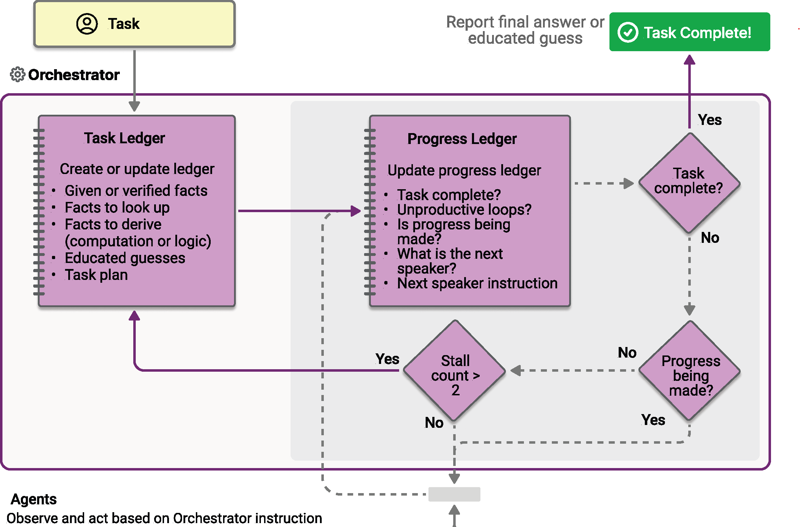
Magentic Orchestration

Slide 51
Magentic Orchestration
Dynamic Coordination: The Magentic manager dynamically selects which agent should act next based on the evolving context
Iterative Refinement: The system can break down complex problems and iteratively refine solutions through multiple rounds
Progress Tracking: Built-in mechanisms to detect stalls and reset the plan if needed
Flexible Collaboration: Agents can be called multiple times in any order as determined by the manager
Human Oversight: Optional human-in-the-loop mechanisms for plan review

Slide 52
Magentic Workflow Execution Flow
Planning Phase: The manager analyzes the task and creates an initial plan
Optional Plan Review: If enabled, humans can review and approve/modify the plan
Agent Selection: The manager selects the most appropriate agent for each subtask
Execution: The selected agent executes their portion of the task
Progress Assessment: The manager evaluates progress and updates the plan
Stall Detection: If progress stalls, auto-replan with an optional human review process
Iteration: Steps 3-6 repeat until the task is complete or limits are reached
Final Synthesis: The manager synthesizes all agent outputs into a final result

Slide 53
Magentic Orchestration
Magentic Orchestration (multi-agent)
magentic.py
Magentic Orchestration with Human Plan Review
magentic_human_plan_review.py

Slide 54
When to use Magentic orchestration
The problem is complex or open-ended with no predetermined solution path.
Input and feedback from multiple specialized agents are needed to shape a valid solution.
The system must generate a documented plan of approach for human review.
Agents have tools that can directly interact with external systems and resources.
A step-by-step, dynamically built execution plan adds value before running the tasks.

Slide 55
When to avoid Magentic orchestration
The solution path is fixed or deterministic.
There’s no need to produce a ledger or plan of approach.
The task is simple enough for a more lightweight orchestration pattern.
Speed is the priority, as this method emphasizes planning over fast execution.
You expect frequent stalls or loops without a clear resolution path.

